Slide 1
MIS771: Week 3 – One–way ANOVA
Abby Shrivastava
Notes:
Accessibility requirements for template users
This PowerPoint template has been created with a number of in-built accessibility options.
When working with this template, there are a few things you will need to do within the file to ensure that it meets Deakin’s accessibility requirements when documents, or exported pdf files, are shared with others or placed online.
Font styles
Only use the provided heading styles and text styles as pre-set in the template
ALT text
All images and graphics, backgrounds, logo and brand shapes need to have ALT text added to describe the image or be indicated as decorative. Elements provided within the template have had this added, but if you make any changes or add your own images/replace any default imagery, you will need to ensure ALT text is added.
If an image is also a hyperlink provide the destination in writing, for example an image of a ‘Hand holding a pen writing in a notebook’ that hyperlinks to Deakin homepage should also explain that the link goes to that page.
ALT text can be added by right clicking on the image/graphic and selecting ‘Edit alt text’ from the window.
Tables
All tables are required to include alt text.
The first row in a Word table can be identified as a header row/table title which can help screen reader users identify what the table content is about and whether they want to read it.
Where tables are already included, a basic form of ALT text will have been added, but you will need to add your own by going into the ‘table properties’ for each table, and clicking on the’ Alt text’ tab, and then completing the fields to provide a suitable description of your content.
Accessibility checker
Word has an inbuilt accessibility checker which can help to flag issues – go to ‘Review > Check accessibility’ in the toolbars.
Saving as a pdf
When saving your file as a pdf, note that using the ‘Print to PDF’ option doesn’t keep any inbuilt accessibility features. Instead use the ‘Save As > PDF’ option, and check that “Document structure tags for accessibility” is selected

Slide 2
Recap
T-test | Z-test
Used when the sample size is small (typically less than 30). Applied when the population standard deviation is unknown. Suitable for comparing the means of two groups. E.g. If you are interested in knowing whether a new training program increases employee productivity. You take a small sample of 20 employees and measure their productivity before and after the training. You don't know the overall population standard deviation for productivity, so you use a t-test to compare the means of the two sets of data (before and after the training). | Used when the sample size is large (typically 30 or more). Applied when the population standard deviation is known. Suitable for comparing the means of a sample to a population mean. E.g. Suppose you work in a company that produces light bulbs, and you know from historical data that the population mean lifespan of a light bulb is 1,000 hours with a standard deviation of 100 hours. You introduce a new manufacturing process and want to determine if it has increased the mean lifespan. You take a large sample of 50 light bulbs and find their mean lifespan to be 1,020 hours.

Slide 3
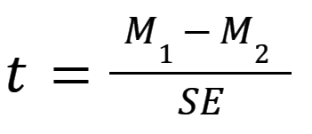

Recap
T-test | Z-test
Sample Mean Difference: Mean before training (M1) = 51.5 Mean after training (M2) = 56.5 Mean difference = 5 T-Statistic Calculation: Critical Value Comparison: Compare t-statistic with critical value from t-distribution table (depends on degrees of freedom and significance level). | Sample mean lifespan of new bulbs = 1,020 hours Population mean lifespan = 1,000 hours Population standard deviation = 100 hours Sample size = 50 Z-Statistic Calculation: Critical Value Comparison: Compare z-statistic with critical value from z-distribution table (commonly 1.96 for a 95% confidence level).

Slide 4
ANOVA
Why the need?
What happens if you have to compare the means of more than two groups? Let’s say three groups?
Can we perform multiple t-tests?
NO, not ideal!
For K independent groups there are K(K-1)/2 possible pairs.
So, if you had 3 independent groups, that would equal 3(3-1)/2 =3 independent t tests!
And those 3 independent t-test would not give us information about the intendent variable overall.
Greater chance of making type I error: multiple pair-wise comparison means the error compounds with each t-test i.e., (5%x3) = 15% (standard alpha value multiplied by the number of tests)

Slide 5
ANOVA
The one-way analysis of variance is used to test the claim that three or more population means are equal
This is an extension of the two independent samples t-test
The response variable (dependant variable) is the outcome or measure that you observe and analyse to see how it changes in response to the factor variable. E.g., productivity of employees, test scores, diet outcome etc.
The factor variable is the independent categorical variable being used to define the groups. E.g., different types of study methods (flashcards, online quizzes, textbooks etc.), different types of diets (diet 1, diet 2, diet 3) etc.
ANalysis Of VAriance

Slide 6
Why is it Called One-Way ANOVA?
The term "One-Way" refers to the fact that this type of ANOVA analyses the effect of a single independent variable (factor) on a single dependent variable.
Example to Illustrate One-Way ANOVA:
Comparing test scores (dependent variable) across different teaching methods (independent variable: traditional, online, blended).

Slide 7
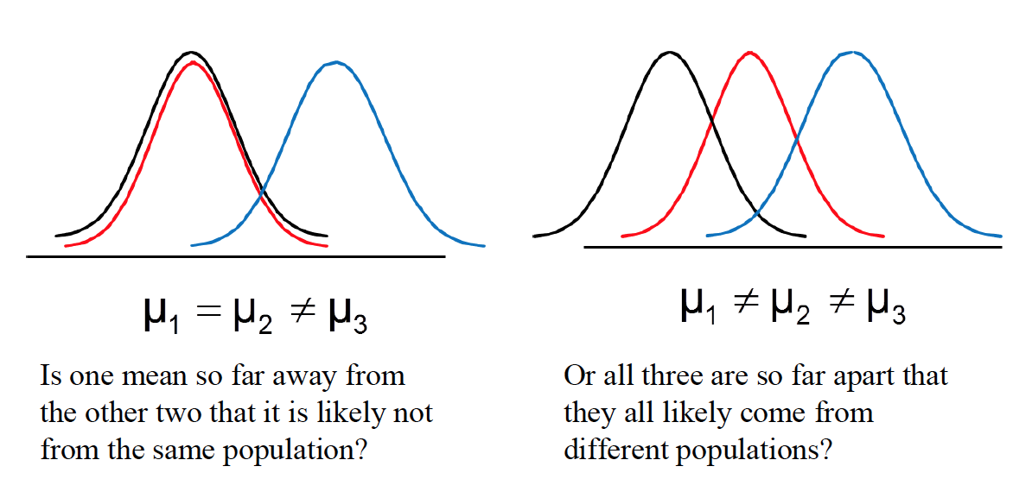
ANOVA – Hypothesis
H₀ : μ₁ = μ₂ = μ₃ = … = μ_{c}
All population means are equal; (no variation in means between groups)
H₁ : Not all the population means are the same
At least one population mean is different; This does not mean that all population means are different (some pairs may be the same).

Slide 8
Activity
The analysis of the 40 employees surveyed found that there were differences in the average Productivity across the three departments – Admin, Production and Distribution
Identify the “response” variable
Identify the “factor” variable and describe the different factors/groups
Write the null and alternative hypothesis for this scenario

Slide 9
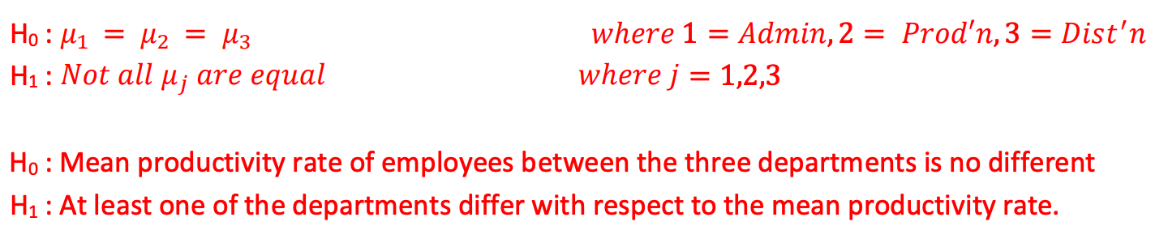
Activity – Solution
The analysis of the 40 employees surveyed found that there were differences in the average Productivity across the three departments – Admin, Production and Distribution
Identify the “response” variable: “Productivity”
Identify the “factor” variable and describe the different factors/groups: Admin, Production and Distribution
Write the null and alternative hypothesis for this scenario

Slide 10

ANOVA – Interpretation
After performing ANOVA, you typically get the following results:
F-Value: A ratio that compares the variance/variability between groups to the variance within groups.
P-Value: The probability that the observed results occurred by chance.
1. F-Value
High F-Value: Indicates that the variance between groups is much larger than the variance within groups, suggesting that there are significant differences between group means.
Low F-Value: Indicates that the variance between groups is similar to the variance within groups, suggesting that any differences between group means are likely due to random variation.
2. P-Value
The p-value helps determine the significance of the F-value.
Low P-Value (typically < 0.05): Indicates that the observed differences between group means are statistically significant, and you can reject the null hypothesis.
High P-Value (typically > 0.05): Indicates that the observed differences between group means are not statistically significant, and you accept the null hypothesis.

Slide 11


Variance (Mean Square = MS)
Variance measures how spread out the numbers in a data set are. It gives us an idea of how much the values differ from the mean (average) of the data set.
Calculation of Variance
Find the Mean: Calculate the average of the data set.
Subtract the Mean: Subtract the mean from each data point to find the difference.
Square the Differences: Square each difference.
Average the Squared Differences: Find the average of these squared differences.
The formula for variance (σ²) is:
OR
Where:
x_{i} = each individual data point
μ = mean of the data set
N = number of data points

Slide 12
Variance (Mean Square = MS)
1. Variance Within Groups:
Definition: This measures how much the data points within each group differ from their own group mean. It shows the variability inside each group.
Why It Matters: High variance within groups means that the individual observations in each group are spread out around the group mean, indicating inconsistency within the group.
2. Variance Between Groups:
Definition: This measures how much the group means differ from the overall mean (the mean of all the data points combined). It shows the variability between the group averages.
Why It Matters: High variance between groups means that the group means are far apart from each other, indicating a difference between the groups.
By comparing these two variances, ANOVA determines if the differences in group means (between-group variance) are significant compared to the natural variability within the groups (within-group variance).

Slide 13
Variance (Mean Square = MS)
Let's say we have three classes of students, and we want to compare their test scores. Here are the test scores for each class:
Class A: 85, 87, 90, 88, 86
Class B: 70, 72, 75, 74, 73
Class C: 90, 91, 92, 93, 94
Calculating the Spread (Variance) Within Each Class
Find the Mean (Average) Test Score for Each Class:
Class A Mean: (85 + 87 + 90 + 88 + 86) / 5 = 87.2
Class B Mean: (70 + 72 + 75 + 74 + 73) / 5 = 72.8
Class C Mean: (90 + 91 + 92 + 93 + 94) / 5 = 92
Calculate How Much Each Score Differs from the Mean:
For Class A: Differences are (85-87.2), (87-87.2), (90-87.2), (88-87.2), (86-87.2)
For Class B: Differences are (70-72.8), (72-72.8), (75-72.8), (74-72.8), (73-72.8)
For Class C: Differences are (90-92), (91-92), (92-92), (93-92), (94-92)
Square Each Difference:
For Class A: (85-87.2)², (87-87.2)², (90-87.2)², (88-87.2)², (86-87.2)²
For Class B: (70-72.8)², (72-72.8)², (75-72.8)², (74-72.8)², (73-72.8)²
For Class C: (90-92)², (91-92)², (92-92)², (93-92)², (94-92)²
4.Calculate the Average of These Squared Differences:
This gives us the variance within each class.
What Does the Spread Tell Us?
Small Spread (Low Variance): If the test scores are close to the mean (like in Class A and Class C), the spread or variance is low. This means the students' scores are similar to each other.
Large Spread (High Variance): If the test scores are spread out from the mean (like in Class B), the spread or variance is high. This means the students' scores are more varied or inconsistent.

Slide 14

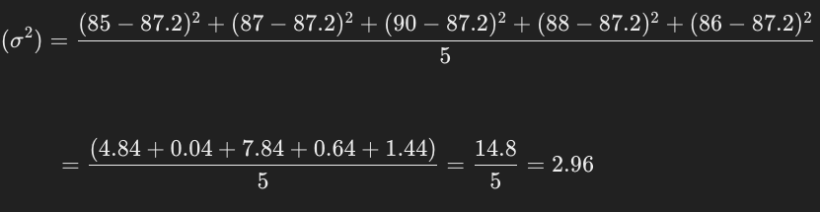

Variance vs Standard Deviation
Variance:
Provides a measure of how spread out the data is.
Used in statistical calculations and formulas (e.g., in ANOVA, regression analysis).
Squared units can exaggerate the effect of outliers.
Standard Deviation:
Easier to interpret because it's in the same units as the data.
Commonly used to describe the dispersion of data points.
Helps in understanding the spread of the data around the mean.
Example: Consider a set of test scores: 85, 87, 90, 88, 86.
Step 1: Calculate the Mean (Average):
Step 2: Calculate the Variance:
Step3: Calculate the Standard Deviation:

Slide 15
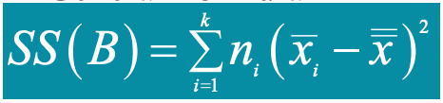

Variation (Sum of Squares)
Variation is the sum of the squares of the deviations between a value and the mean of the value
Sum of Squares is abbreviated by SS and often followed by a variable in parentheses such as SS (T)otal, SS(B)etween or SS(W)ithin so we know which sum of squares we’re talking about

Slide 16
Variation (Sum of Squares)
SS(T) | SS(B) | SS(W)
Are all of the values identical? No, so there is some variation in the data This is called the total variation Denoted SS (T) for the total Sum of Squares (variation) | Are all of the sample means identical? No, so there is some variation between the groups This is called the between group variation Sometimes called the variation due to the factor Denoted SS(B) for Sum of Squares (variation) between the groups | Are each of the values with each group identical? No, so there is some variation within the groups This is called the within group variation Sometimes called the error variation Denoted SS(W) for Sum of Squares (variation) within the groups

Slide 17
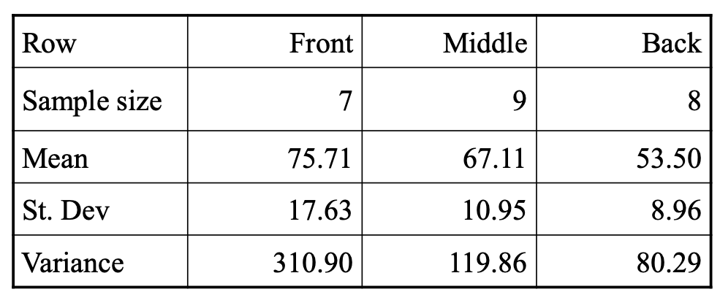
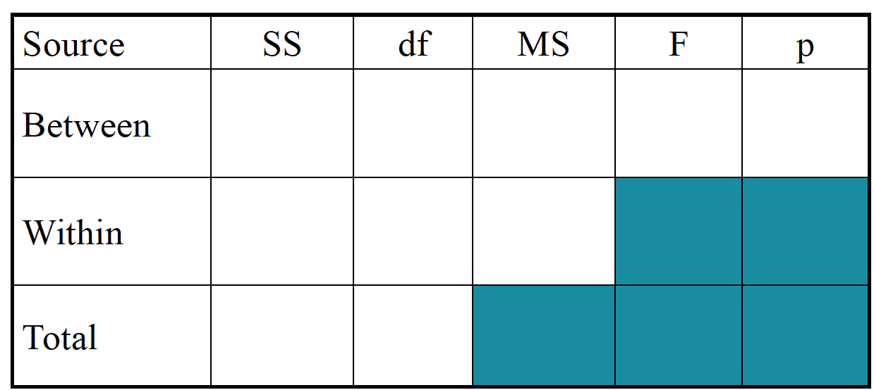
ANOVA – Example
The summary statistics for the grades of each row are shown in the table below.

Slide 18
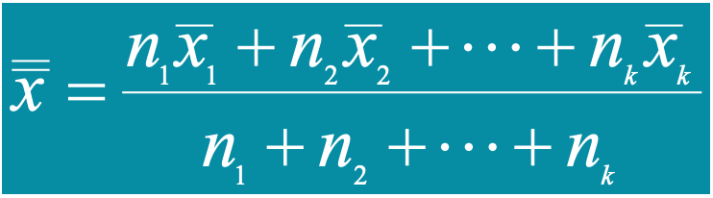
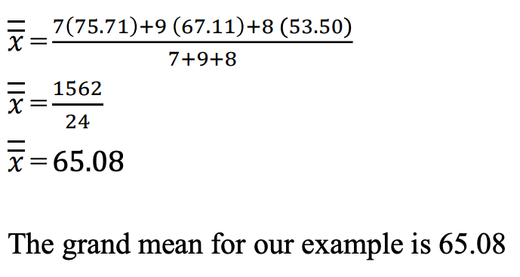
ANOVA: Example – Step 1
Computing Grand Mean
It is a weighted average of the individual sample means
Here
n = Sample size
x (bar) = individual sample mean

Slide 19
ANOVA: Example – Step 2
SS(T) | SS(B) | SS(W)
SS(T) = SS(B) + SS(W) = 5288 | SS(B) = 7(75.71-65.08)² + 9(67.11-65.08)² + 8(53.50 - 65.08)² = 1901.5 (or approx. 1902) | The weighting is done with the df; the df for each sample n – 1 Front df = 7-1= 6; Var = 310.90 Middle df = 9-1=8; Var = 119.86 Back df =8-1=7; Var = 80.29 SS(W) = 6(310.90) + 8(119.86) + 7(80.29) = 3386.31 (or approx. 3386)

Slide 20
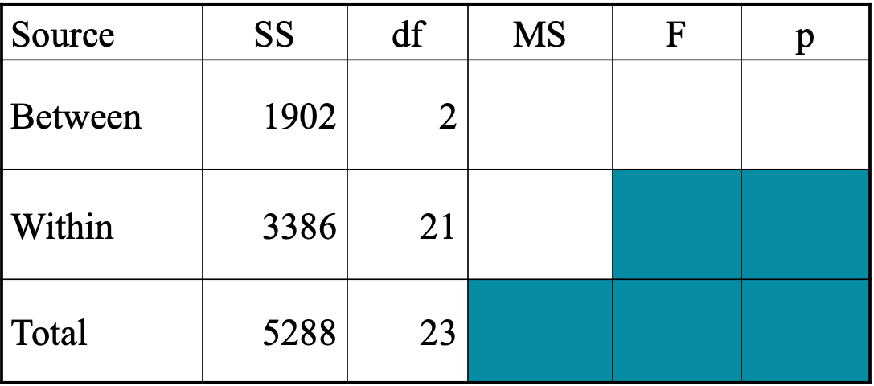
ANOVA: Example – Step 3
Variance
Degrees of Freedom
The between group df is one less than the number of groups
We have three groups, so df(B) = 2
The within group df is the sum of the individual df’s of each group
The sample sizes are 7, 9, and 8
df(W) = (7-1) + (9-1) + (8-1) = 21
The total df is one less than the sample size
df(Total) = (7+8+9) – 1 = 23

Slide 21
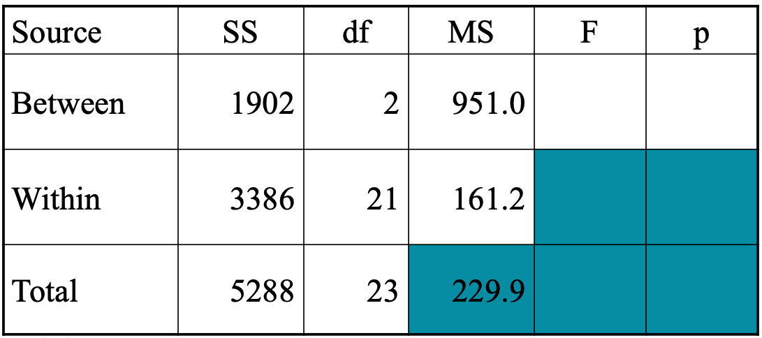
ANOVA: Example – Step 4
Variance
MS = SS / df
MS(B) = 1902 / 2 = 951.0
MS(W) = 3386 / 21 = 161.2
MS(T) = 5288 / 23 = 229.9
Notice
The MS(Total) is NOT the sum of MS(Between) and MS(Within).
The MS(Total) isn’t usually shown

Slide 22
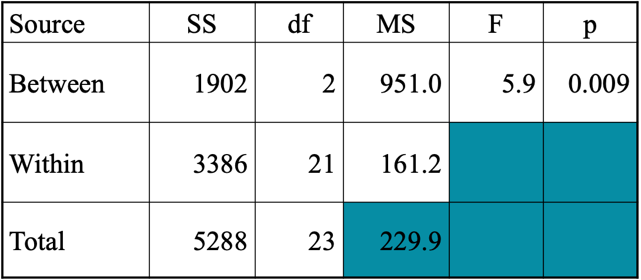
ANOVA: Example – Step 5
alpha%
F-Statistic and Effect
Critical Value (CV) for F (5%, 2, 21) = 3.47
(we need to look at the CV table)
If computed F > 3.47 we reject the null hypothesis
F= MS(B)/MS(W) = 951.0 / 161.2 = 5.9
5.9>3.47
Need to check if the probability that the observed differences in means happened by chance, P(F2,21 > 5.9) = 0.009
I used – Quick P-Value from F-Ratio Calculator (ANOVA) (socscistatistics.com)

Slide 23
ANOVA: Example – Interpretation
The p-value is .00926. The result is significant at p < .05, so we reject Null Hyp.
There is enough evidence to support the claim that there is a difference in the mean scores of the front, middle, and back rows in class.
So, at least one row has a different mean.
The ANOVA doesn’t tell which row is different, you would need to look at confidence intervals or run post hoc tests to determine that

Slide 24
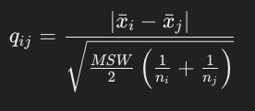
Tukey-Kramer Procedure
The Tukey-Kramer procedure is a post hoc test used after rejection of equal means in ANOVA when you want to make pairwise comparisons between group means.
It helps determine which specific groups' means are significantly different from each other.
This procedure is useful when you have unequal sample sizes in different groups.
When to Use the Tukey-Kramer Procedure
After ANOVA: When the ANOVA indicates that there are significant differences among group means.
Multiple Comparisons: To compare all possible pairs of group means.
Unequal Sample Sizes: It adjusts for unequal sample sizes in the groups being compared.
Here
x_{i} = Mean of group I
x_{j} = mean of group j
MSW = variance within groups
n_{i} = Sample size of group i
n_{j} = Samples size of group j
Std. Error

Slide 25
Tukey-Kramer Procedure
Group | Sample Mean | Sample Size
Front | 75.71 | 7
Middle | 67.11 | 9
Back | 53.5 | 8
Finding the Critical Value or Q statistics
The critical value Q can be found using the Tukey HSD (Honestly Significant Difference) table, which provides the critical values for the Studentized range distribution. You need to know:
The number of groups (c) = 3 (Numerator df)
The total number of observations minus the number of groups (n−c) = (7+8+9) – 3 = 21 (Denominator df)
The significance level (usually 0.05 for 95% confidence)
Other Data
Significance | 0.05
Numerator df | 3
Denominator df | 21
MSW | 161.25
Q Statistics (from the table) | 3.58

Slide 26
Tukey-Kramer Procedure
Group | Sample Mean | Sample Size
Front | 75.71 | 7
Middle | 67.11 | 9
Back | 53.5 | 8
Comparison | Difference of Means (x) | Std Error (SE) | Q = x/SE | Results
Comparing Front and middle | 8.6 | 4.525062483 | 1.900526243 | Means are not different
Comparing Front and Back | 22.21 | 4.647147743 | 4.779275639 | Means are different
Comparing Middle to Back | 13.61 | 4.363078997 | 3.119356768 | Means are not different
Other Data
Significance | 0.05
Numerator df | 3
Denominator df | 21
MSW | 161.25
Q Statistics (from the table) | 3.58

Slide 27
Thank You

